Slide 1
Bollywood Dancing in Brixham
Hello, I’m Victoria and I started working as a Community Builder over 6 years ago.
I have always naturally been a community builder my whole, life, seeing everything in my community as an asset, people, buildings, green spaces, just about anything. During this time I have seen the community of Brixham thrive, new groups starting, people feeling inspired by others achievements. This has created a virtuous circle of positiveness. Personally I had always wanted to share my Yoga practice but before becoming a Community Builder I had no idea or confidence of how to even start this off. So utilizing the skills I had acquired, I found a room and got a small amount of pump funding to buy mats. I have been teaching donation based Yoga now for over 6 years, filling my classes to the maximum, this helped me help others to get starting with their dreams.

Slide 2
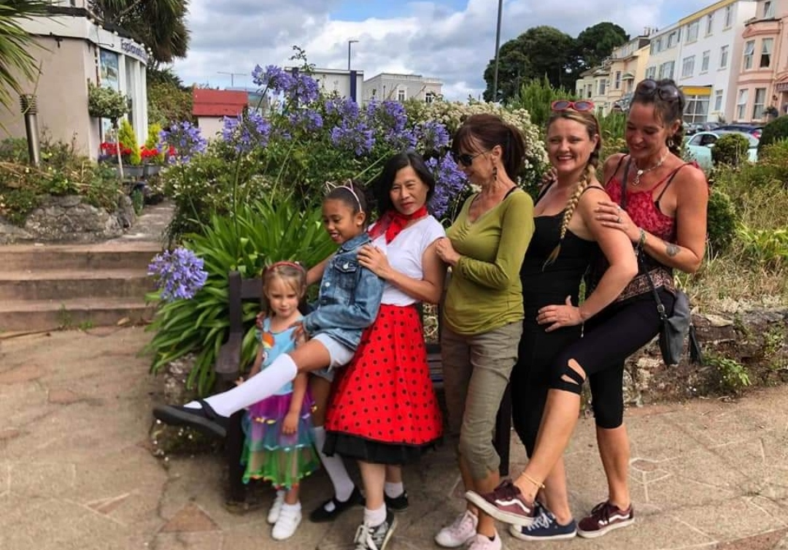
Nicola Hall is a professional dancer, now teaching her skills world wide. She started coming to my Yoga classes and got net- working with the other people that came along. Nicola found that a lot of the ladies were interested in learning some Bollywood dancing. So I helped her find a space to dance, helped her to advertise and just let people within the community who I connected with know about her dance classes. Nicola only needed a small amount of guidance and her classes flourished, reaching many within Brixham that would not normally get the chance or opportunity to explore dance. They now, as a team, get invited to all kinds of functions and celebrations around Torbay and Devon. They dress up and create magic with their happiness

Slide 3
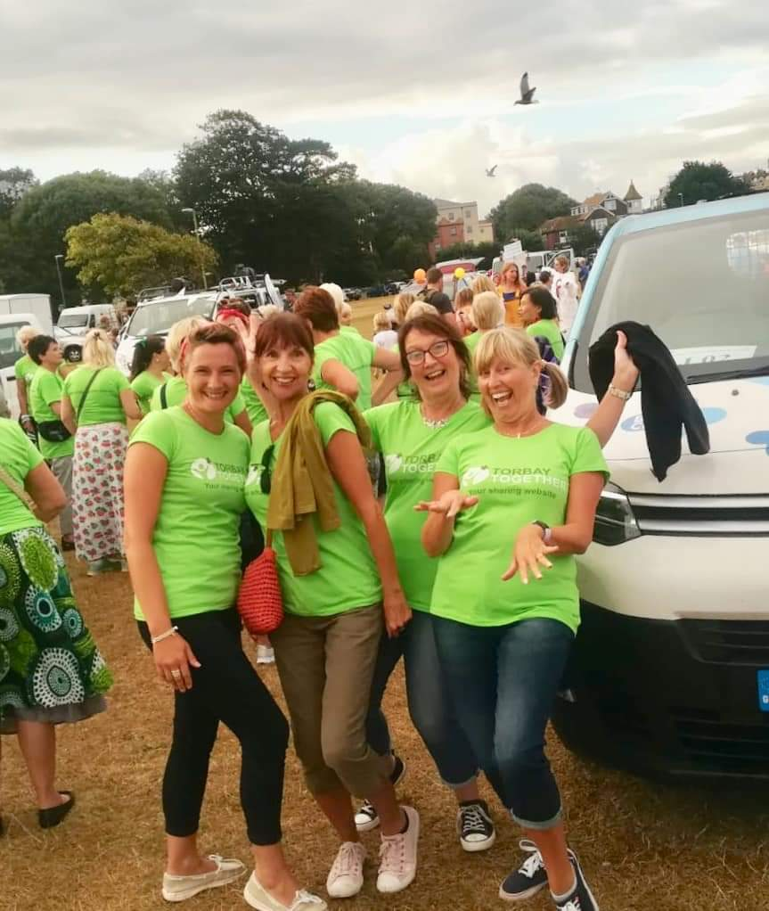
This has been an amazing experience for the local ladies, giving them the chance to dance around Torbay, helping to build new friendships.
This photo was taken with the Ageing Well Flashmob at the Torbay Carnival.

Slide 4
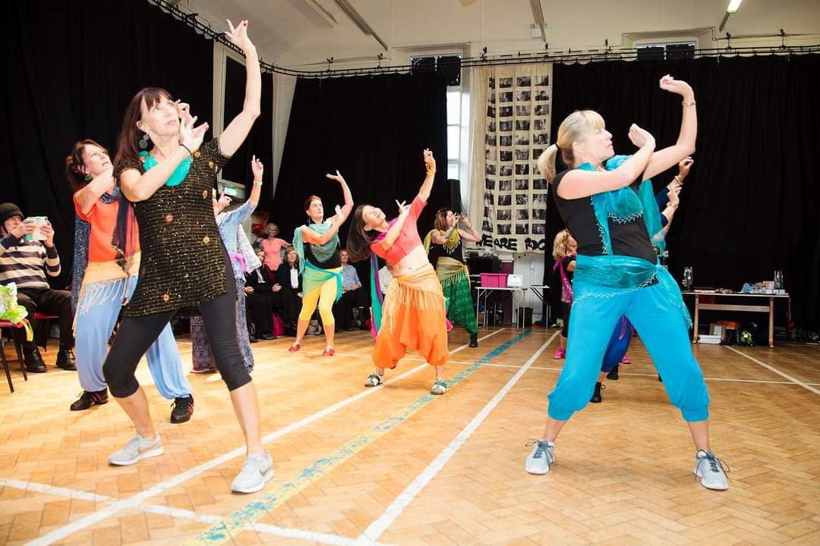
Since starting Bollywood dancing in Brixham we have created a strong dance team and now get invited along to events to show our dancing skills.

Slide 5
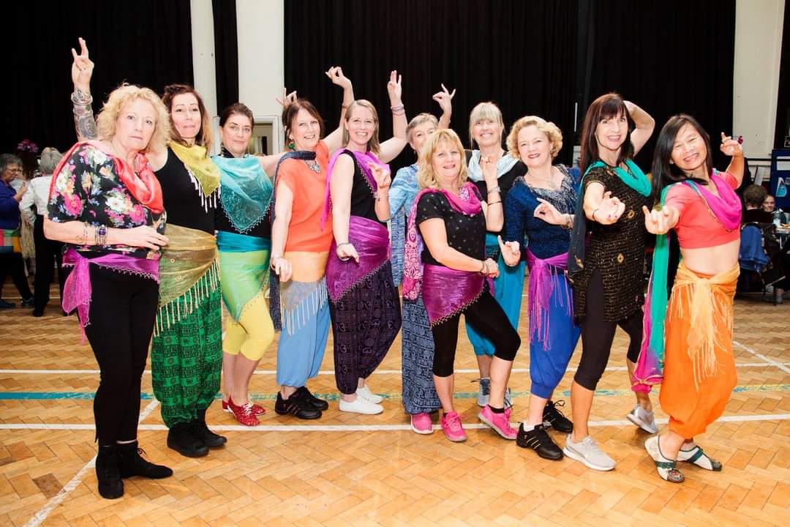
This is the Bollywood ladies all dressed up in their finest wear for an event we danced at.

Slide 6
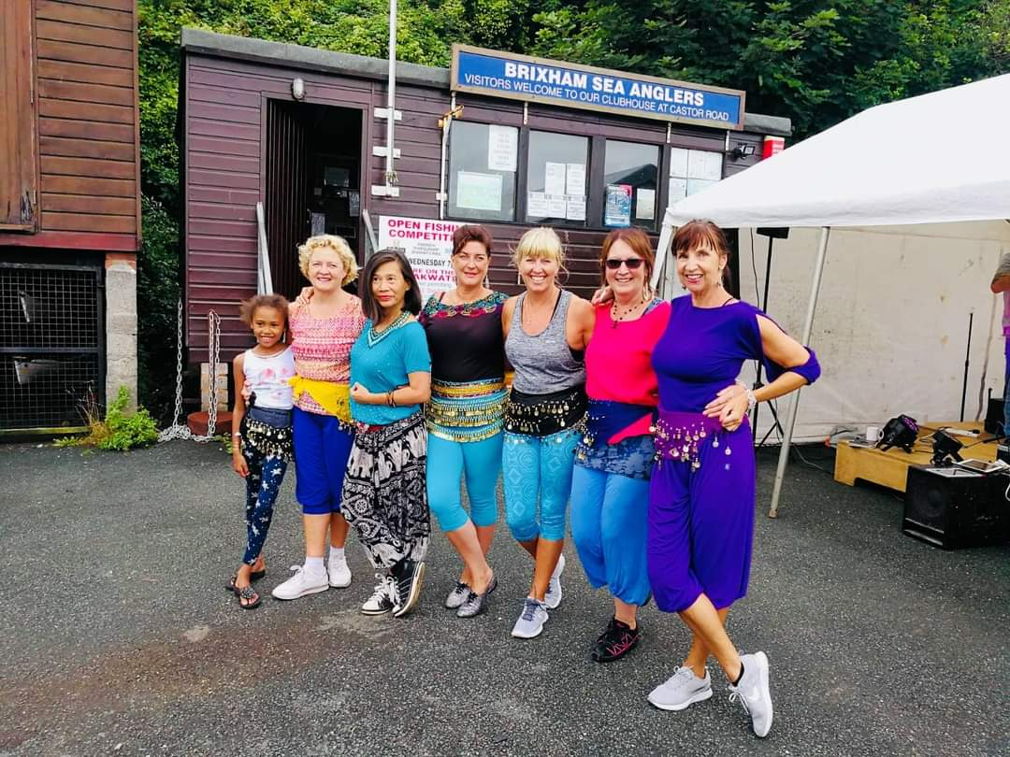
During the summer in Brixham we have a lot of outdoor events. We were invited to dance by the Brixham RNLI for the Brixfest festival which is held all over Brixham over a few days. We like to support our community so usually get invited to dance, which is great as it shows other members of the community what we are doing.

Slide 7
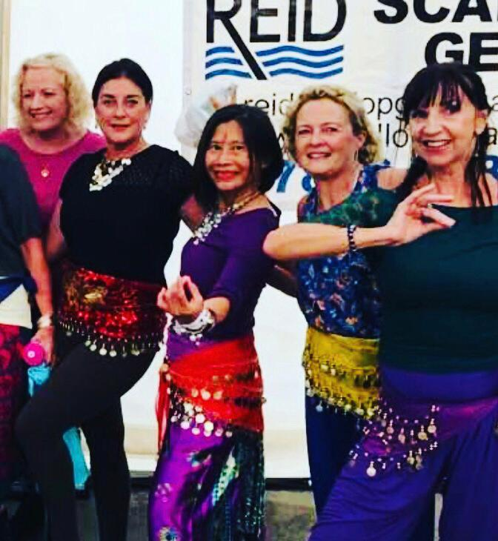
This was taken at Fishstock, a Brixham seafood and music festival. Since the pandemic, Nicola has continued to teach on zoom and is also adding other dancing styles to her repertoire.

Slide 8
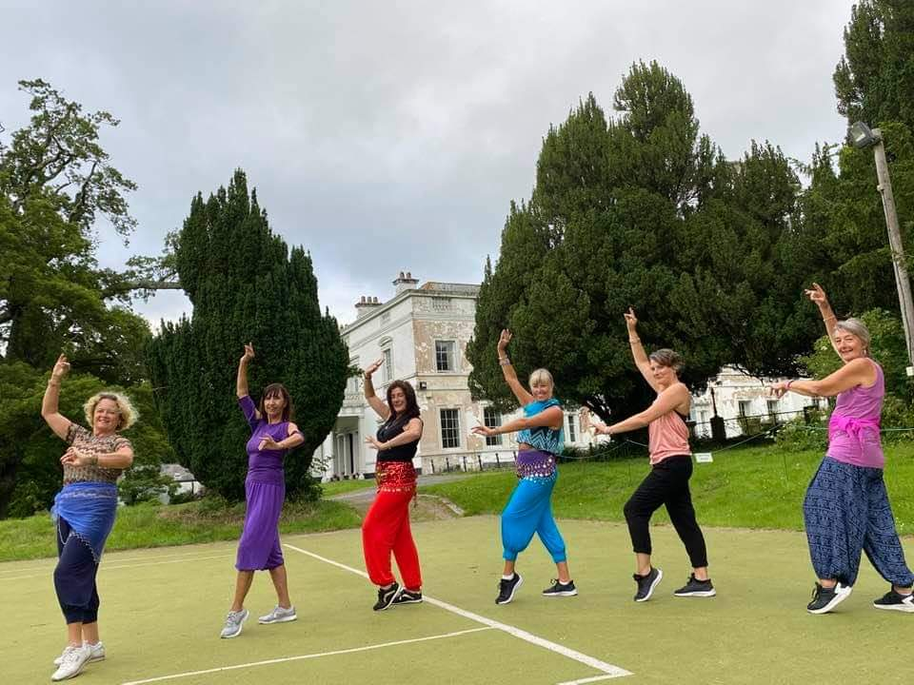
When the weather is good and whenever we are allowed back out, but with social distancing in place, she teaches outdoors at Lupton House. In between lockdowns, last year, we were fortunate to have this outdoor space to continue our dancing, keeping our spirits high and making sure we kept connected with each other.

